Slide 1
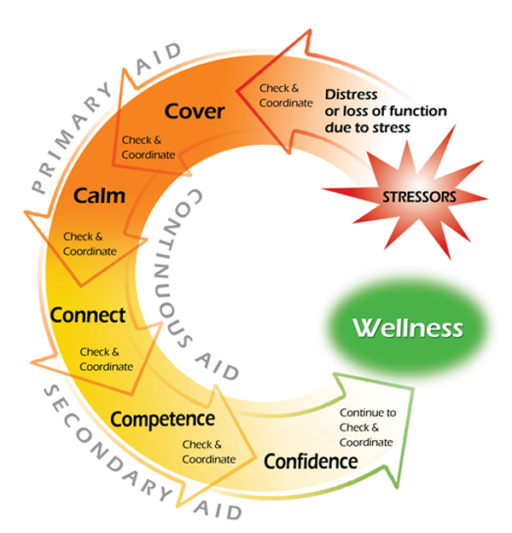
The Seven Cs of Stress First Aid
Continuous Aid
Check: Assess: observe & listen
Coordinate: Get help and refer as needed
Primary Aid
Cover: Get to safety immediately
Calm: Relax, slow down, refocus
Secondary Aid
Connect: Get support from others
Competence: Restore effectiveness
Confidence: Restore self-esteem and hope
Notes:
The Seven C's of Stress First Aid
The “Seven C’s” are designed to facilitate successful coping and:
Reduce the initial distress caused by traumatic events
Foster short and long-term resilience
Augment and promote repair of support structures damaged by trauma or loss
Reduce excessive, uncontrollable distress
Correct negative self-thoughts
Facilitate social connectedness
Provide self-help resources
Identify when normal healing and recovery doesn’t occur, and facilitate help for individuals and the unit.
Continuous aid includes the two stress first aid actions, check and coordinate, to be considered by leaders of Marines and Sailors all the time.
-Navy and Marine Corps leaders must continuously assess and reassess the stress zones of unit and family members in order to know who is at risk and who is in need of treatment or other care. Leaders must also continuously make judgments about what additional resources or referrals may be needed by their Sailors or Marines in order to master the challenges they face and recover from stress reactions, injuries, or illnesses.
-Cover and calm should also be considered first when responding to a stress injury in another person or in oneself and are typically only used briefly in situations of intense distress or losses of function.
-These secondary aid actions should be considered once it is clear that either the primary aid actions of cover and calm are no longer needed or they were never needed at all.
-The secondary aid actions tend to be more the responsibility of military leaders and their religious ministry and medical support personnel than the two primary aid actions. Furthermore, secondary aid actions tend to be needed over a longer period of time during the process of recovering from a stress injury or illness.
-

